Slide 1
IT Presentation

Slide 2
Agenda
HDDs
Raid
Filesystem
Linux Kernel
NAS
Storage in Companies

Slide 3
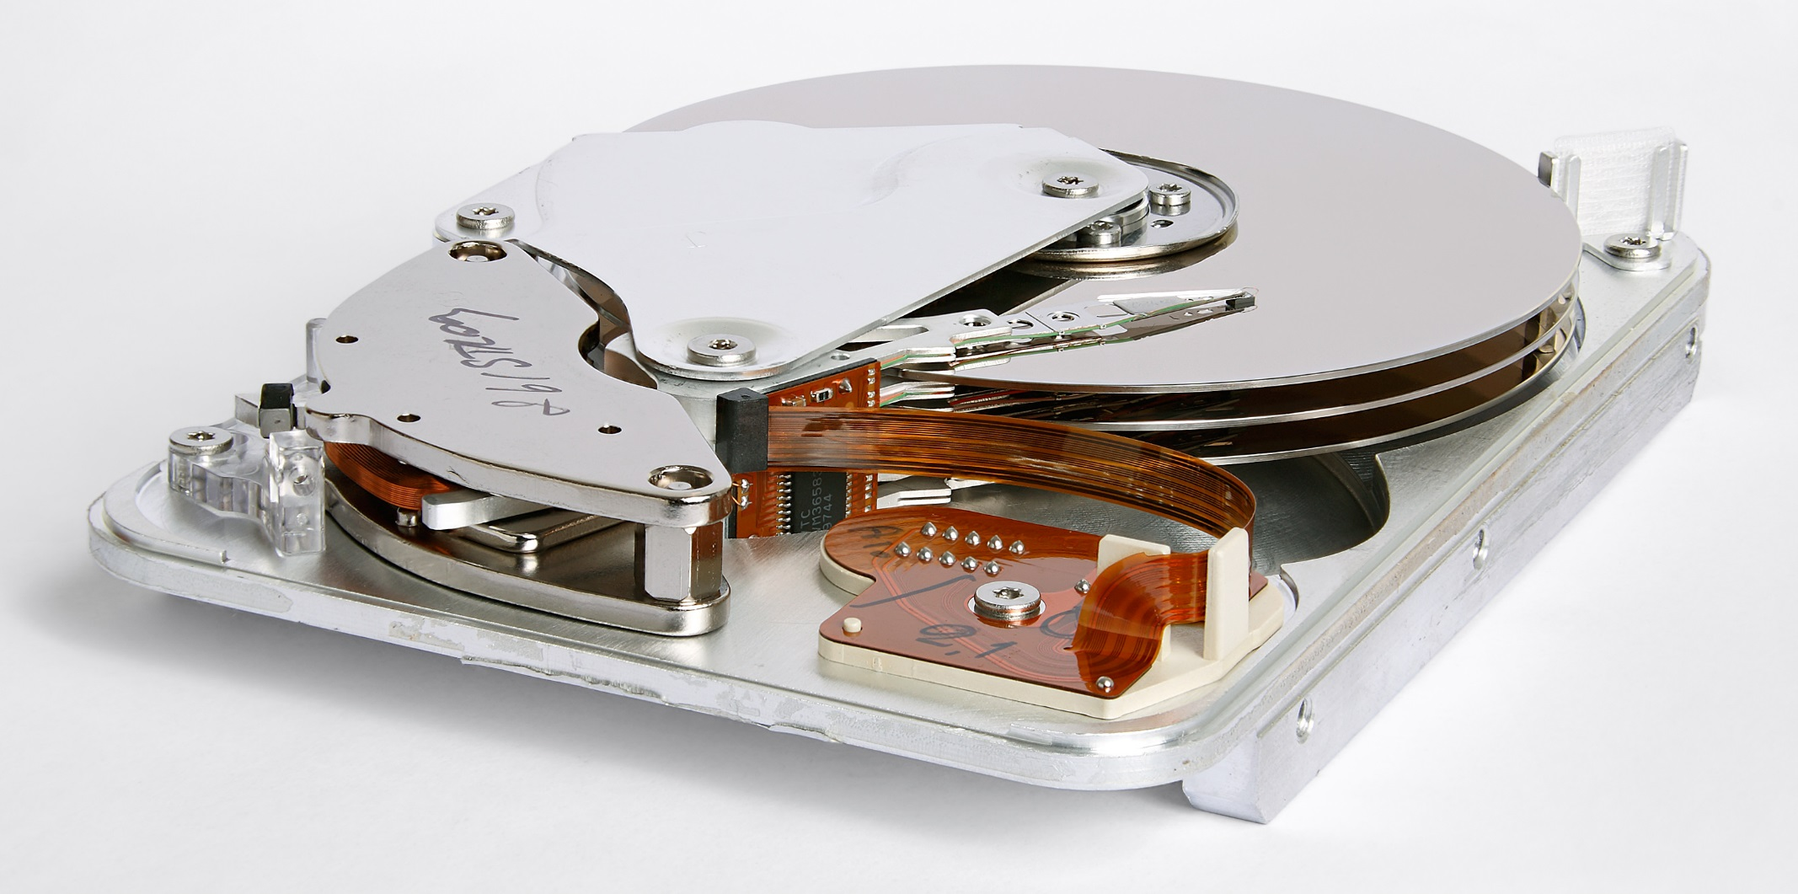
HDDs – Physical disk units
Cylinder / Track
Sector
Platter
Head

Slide 4

HDDs - Sectors
…
4
1
3
2
1
2
3
4
…

Slide 5
HDDs – Logical vs. physical
1
2
3
4
…
Logical disk
Physical disk 1
Physical disk 2
Physical disk 3
Physical disk 4
1
2
3
4
…
Disk 1
Mirror disk 1

Slide 6
HDDs – tDisk
tDisk
USB Stick
HDD SATA / IDE / ….
File
Cloud
HTTP Request

Slide 7
HDDs – Size Units
1 GB = 1.000 MB = 1.000.000 KB = 1.000.000.000 Byte
1 GiB = 1024 MiB = 1.048.576 KiB = 1.073.741.824 Byte
0,93 GiB = 953,67 MiB = 976.562,5 KiB = 1.000.000.000 Byte
Hardware Producers: GB, TB…
Operating Systems: GiB, TiB… (Windows names it wrong!)

Slide 8
Raid
Combining multiple Physical disks into (multiple) logical disks
Data protection
Performance (Striping)
Raid 0, 1, 5, 6
Hardware vs. Software

Slide 9
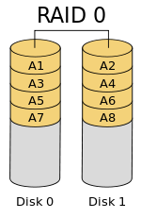
Raid 0
Striping
Gain higher performance
No redundancy
No capacity „wasted“

Slide 10
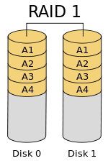
Raid 1
Mirroring
50% Capacity „wasted“
„Bad“ Performance

Slide 11
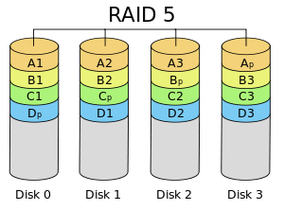
Raid 5
At least 3 disks
Parity distributed across disks
Increased performance
Less storage „wasted“

Slide 12
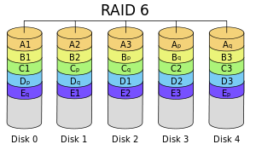
Raid 6
= Raid 5 + another parity block
At least 4 disks
Better data safety
More storage „wasted“ than raid 5

Slide 13
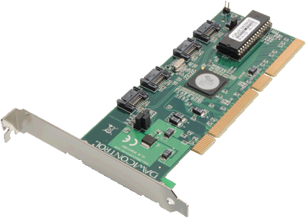
Raid – Software vs. Hardware
Better performance
Own CPU
OS independent
Relatively expensive
PCI slot needed

Slide 14
Raid
Hot Spare
One or more disks present in case of failure
Combining Raids
E.g. Raid 10, Raid 15…
Performance + data safety
tDisk advantage: flexibility, continuous optimization

Slide 15
Filesystem
= Software to manage Files (Inodes) on a disk (logical / physical)
Independent of underlying device
Inode
= file + metadata (Permissions, attributes, disk location, modify time…)
Examples
FAT, NTFS, EXT, ZFS…

Slide 16
Filesystem – Inode table
List of Inodes (Files and folders)
Predefined position where stored on disk
Name: C:\Test
Owner: Tom
Permissions: …
Modification Time: …
Data blocks: 12, 13, 14, 100, 101

Slide 17
Filesystem - Fragmentation
Modern filesystems
Not only files – also RAM
When growing

Slide 18
Linux Kernel
Block vs. Char device
Block layer
/dev/…
tDisk block view

Slide 19
Linux Kernel – Block vs. Char device
Block devices (e.g. HDD, tDisk…)
A value at a location is the value that was last written there
Reads can be cached
Writes can be buffered
Normally seekable
Name: Usually one or more blocks (sectors; 512 byte) are read/written
Character devices (e.g. Audio, Video, Serial Port, Mouse, Keyboard…)
Writing or reading is an immediate action
Reading might cause waiting for data
Name: Each character is handled individually

Slide 20
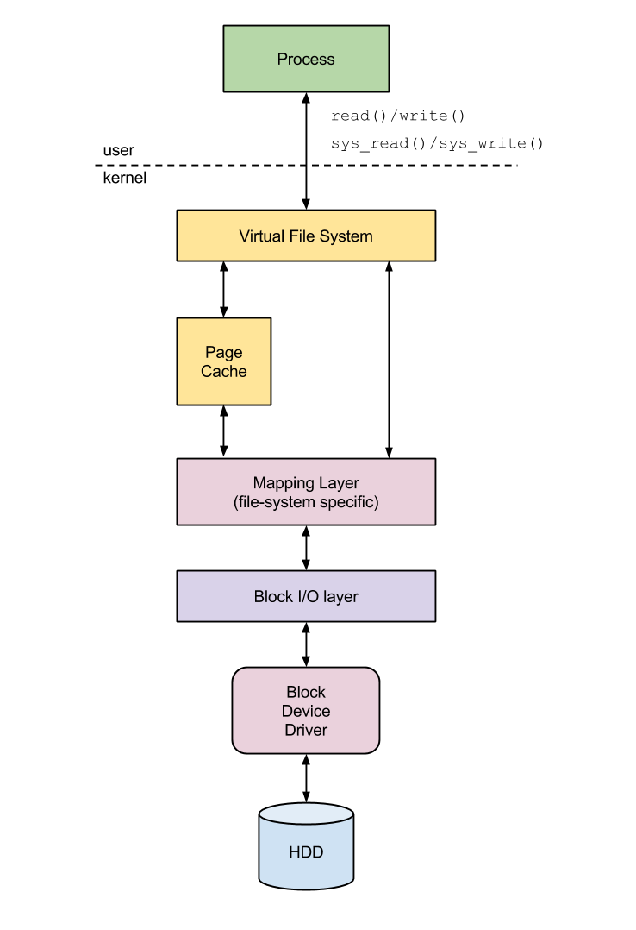
Linux Kernel – Block layer
Process accesses with read(), write()
VFS receives request, checks if buffered
Fragmented files are „mapped“ together
IO requests are sent to driver
Driver physically reads/writes data

Slide 21

Linux Kernel - /dev/…
Block device
Major = driver
In Unix „everything is a file“
/dev/… contains special files
Block special file
Character special file
Interfaces to device drivers
Major and minornumber
Simplifies and unifies driver communication
Naming: fb (framebuffer), hd (IDE disks), sd (SCSI, SATA, USB), tty (Terminal)…
Minor = particular device

Slide 22
tDisk – Block view
Process
Plugin
User
Kernel
VFS
File
Plugin
…
Block device driver, SATA…
tDisk driver
Netlink
Block device
HDD

Slide 23
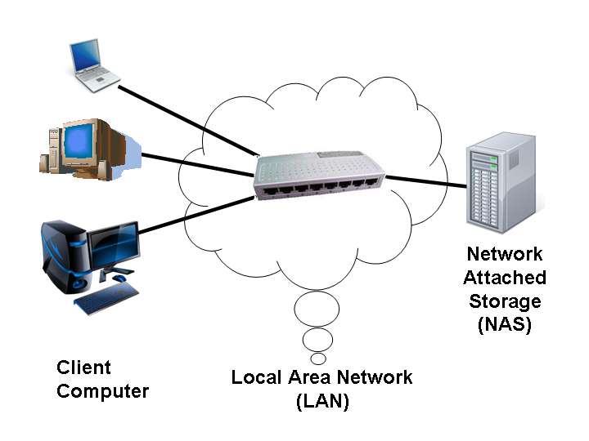
NAS
Network Attached Storage
= Device attached to network which shares files and folders using CIFS, NFS or HTTP
One or more hard disks

Slide 24
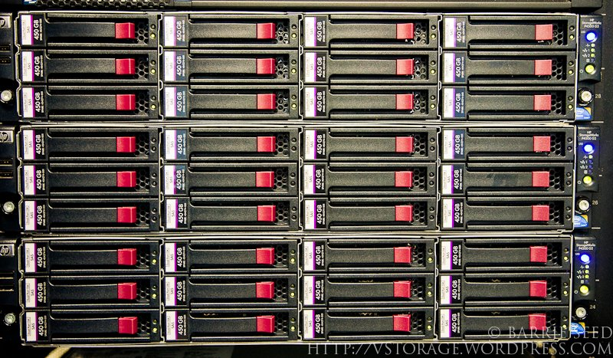
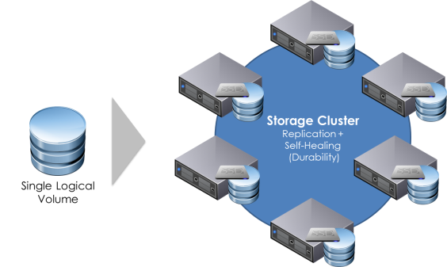
Storage in companies
NAS vs SAN
SAN ~ NAS but:
Block level access to data
Server manages filesystem
Attached via fibre channel or SCSI
No IP connectivity
Multi tier storage
Distributed storage (Cluster)

